Slide 1
Building Graphical User Interface (GUI) in JAVA

Slide 2
GUI in JAVA
GUI (Graphical User Interface) in Java
Gives an easy-to-use visual experience for Java applications
Plays an important role to build easy interfaces for Java applications
It is mainly made of graphical components like buttons, labels, windows, etc.
Through which the user can interact with an application
Can be developed by
Re-using the graphics packages provided by Java
Not so difficult

Slide 3
GUI in JAVA
Three sets of Java APIs for graphics programming
AWT (Abstract Windowing Toolkit)
Introduced in JDK 1.0
Most of the AWT UI components have become obsolete
Swing
Introduced as part of Java Foundation Classes (JFC)
After the release of JDK 1.1
A much more comprehensive set of graphics libraries
JavaFX
Integrated into JDK 8
Meant to replace Swing
Moved out from the JDK in JDK 11
But still available as a separate module

Slide 4
GUI in JAVA
Other than AWT / Swing / JavaFX graphics APIs provided in JDK
Other organizations / vendors have also provided graphics APIs that work with Java such as
Eclipse's Standard Widget Toolkit (SWT) (used in Eclipse)
Google Web Toolkit (GWT) (used in Android)
3D Graphics API such as Java bindings for OpenGL (JOGL)
Java3D
Etc.

Slide 5
Abstract Window Toolkit (AWT)
AWT
A platform dependent API
AWT is rarely used now days because of
Platform dependent
Java AWT calls native platform (Operating systems) subroutine for creating components such as textbox, checkbox, button etc.
Heavy-weight nature
AWT components are being generated by underlying operating system (OS)

Slide 6
Abstract Window Toolkit (AWT)
AWT
Consists of
12 packages of 370 classes
Only 2 packages
Commonly-used
java.awt
java.awt.event

Slide 7
Abstract Window Toolkit (AWT)
The java.awt package
Contains the core AWT graphics classes such as
GUI Component classes such as
Button, TextField, Label etc.
GUI Container classes such as
Frame, Panel, Window etc.
Layout managers such as
FlowLayout, BorderLayout, GridLayout etc.
Custom graphics classes such as
Graphics, Color, Font etc.

Slide 8
Abstract Window Toolkit (AWT)
The java.awt.event package
Supports event handling
Contains Event classes such as
ActionEvent, MouseEvent, KeyEvent ,WindowEvent etc.
Event Listener Interfaces such as
ActionListener, MouseListener, MouseMotionListener, KeyListener , WindowListener etc.
Event Listener Adapter classes such as
MouseAdapter, KeyAdapter, WindowAdapter etc.

Slide 9
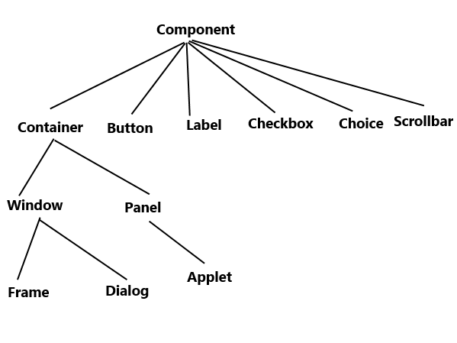
Abstract Window Toolkit (AWT)

Slide 10
Abstract Window Toolkit (AWT)
Two groups of Graphics elements
Component (Widget, Control)
Components are elementary GUI entities
Example: Button, Label, TextField etc.
Called widgets, controls in other graphics systems
Container
Used to hold components in a specific layout
such as FlowLayout, GridLayout, etc.
Can also hold sub-containers
Example: Frame, Panel, Window etc.

Slide 11
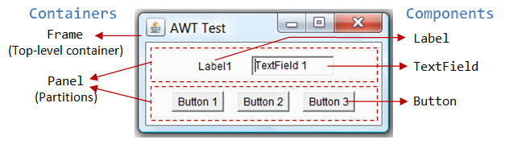
Abstract Window Toolkit (AWT)
Three containers
A Frame
A top-level container
A title bar (containing an icon, a title, and the minimize/maximize/close buttons)
An optional menu bar and the content display area
Contains two Panels
A rectangular area used to group related GUI components in a certain layout
Contains two Panels
Five components:
A Label (providing description)
ATextField (for users to enter text)
three Buttons (for user to trigger certain programmed actions).

Slide 12
Abstract Window Toolkit (AWT)
Two groups of Graphics elements
Component (Widget, Control)
Components are elementary GUI entities
Example: Button, Label, TextField etc.
Called widgets, controls in other graphics systems
Container
Used to hold components in a specific layout
such as FlowLayout, GridLayout, etc.
Can also hold sub-containers
Example: Frame, Panel, Window etc.

Slide 13
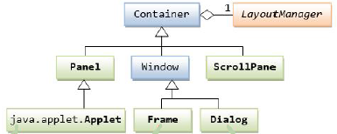
Abstract Window Toolkit (AWT) Java container Classes
The hierarchy of the AWT Container class
Secondary Containers
Top Level Containers

Slide 14
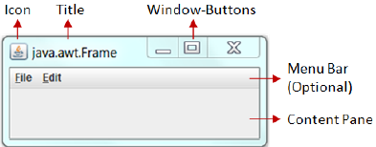
Abstract Window Toolkit (AWT) Top-Level Containers
Each GUI program has a top-level container
The commonly-used top-level containers in AWT are
Frame, Dialog and Applet
A Frame provides the main window for the GUI application with
A title bar (contains an icon, a title, the minimize & maximize and close buttons)
An optional menu bar
The content display area

Slide 15
Abstract Window Toolkit (AWT) Top-Level Containers
Writing a GUI program typically starts with
By extending Frame class (inheritance)
Example :
import java.awt.Frame; // Using Frame class in package java.awt
import java.awt.*;
public class AWT_Example_1 extends Frame
{
public AWT_Example_1()
{
setTitle("Awt Example : Frame");
setSize(500, 300);
}
public static void main(String[] args)
{
AWT_Example_1 ae_1 = new AWT_Example_1();
ae_1.setLocation(200,200);
ae_1.setVisible(true);
}
}

Slide 16
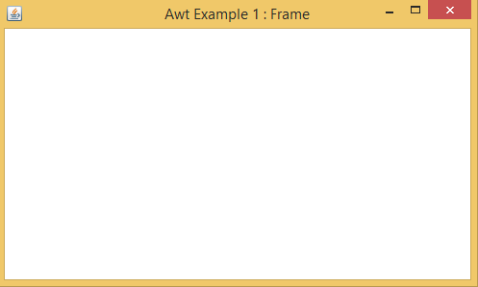
Abstract Window Toolkit (AWT) Top-Level Containers
Output :

Slide 17
Abstract Window Toolkit (AWT) Top-Level Containers
By creating the object of Frame class (association)
Another Example :
import java.awt.*;
public class AWT_Example_2
{
Frame mainFrame;
private AWT_Example_2()
{
mainFrame = new Frame("AWT Example 2 : Frame");
mainFrame.setLocation(200, 200);
mainFrame.setSize(500, 300);
mainFrame.setVisible(true);
}
public static void main(String[] args)
{
AWT_Example_2 ae_2 = new AWT_Example_2();
}
}

Slide 18
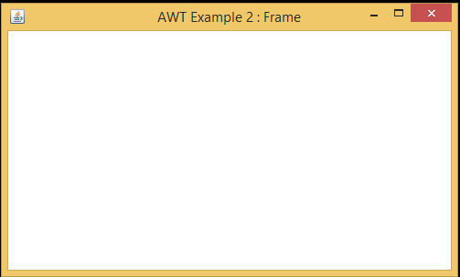
Abstract Window Toolkit (AWT) Top-Level Containers
Output :

Slide 19
Abstract Window Toolkit (AWT) Top-Level Containers :: Frame
While creating a frame
Following two attributes are must for visibility of the frame:
setSize (int width, int height);
setVisible(true);
When creating other components like Buttons, TextFields, etc.
Need to be added it to the frame by using the method
add(Component's Object);
For resizing the frame, The following method can be used
setResizable(true);

Slide 20
Abstract Window Toolkit (AWT) Top-Level Containers
An AWT Dialog
A pop-up window
Used for interacting with the users
A Dialog has
A title-bar (containing an icon, a title and a close button)
A content display area

Slide 21
Abstract Window Toolkit (AWT) Top-Level Containers
Two kinds of Dialog windows
Modal Dialog window
When active, all the user inputs are directed to it
Until closed, all other parts of the application are inaccessible
Modeless Dialog window
When active, all the user inputs are directed to it
the other parts of application are still accessible as normal without needing to close this modeless dialog window

Slide 22
Abstract Window Toolkit (AWT) Top-Level Containers
Example on AWT Modal Dialog
import java.awt.*;
public class AWT_3 extends Frame
{
Dialog Dialog_1;
private AWT_Example_3()
{
setTitle("AWT 3 : Modal Dialog“, true);
setLocation(200, 200);
setSize(500, 300);
setVisible(true);
}
public void add_dialog()
{
Dialog_1 = new Dialog(this, "Modal Dialog“, true);
Dialog_1.setLocation(200, 200);
Dialog_1.setSize(500, 300);
Dialog_1.setVisible(true);
}
public static void main(String[] args)
{
AWT_3 ae_3 = new AWT_3();
ae_3.add_dialog();
}
}

Slide 23
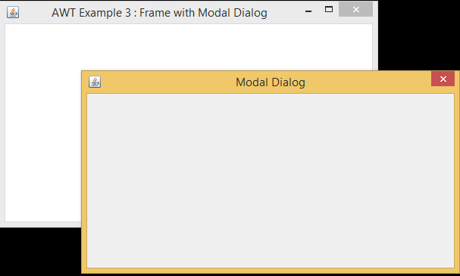
Abstract Window Toolkit (AWT) Top-Level Containers
Output:

Slide 24
Abstract Window Toolkit (AWT) Top-Level Containers
Example on AWT Modeless Dialog
import java.awt.*;
public class AWT_3 extends Frame
{
Dialog Dialog_1;
private AWT_Example_3()
{
setTitle("AWT 3 : Modeless Dialog);
setLocation(200, 200);
setSize(500, 300);
setVisible(true);
}
public void add_dialog()
{
Dialog_1 = new Dialog(this,"Modeless Dialog“, false);
Dialog_1.setLocation(200, 200);
Dialog_1.setSize(500, 300);
Dialog_1.setVisible(true);
}
public static void main(String[] args)
{
AWT_3 ae_3 = new AWT_3();
ae_3.add_dialog();
}
}

Slide 25
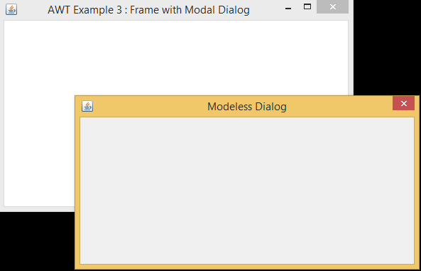
Abstract Window Toolkit (AWT) Top-Level Containers
Output:

Slide 26
Abstract Window Toolkit (AWT) Top-Level Containers
An AWT Applet (in package java.applet)
The top-level container for an applet
Which is a Java program running inside a browser

Slide 27
Abstract Window Toolkit (AWT) Secondary Containers :: Panel
Panel is the simplest container
A generic container
For holding any other component including other panels
Does not contain
Title bar, menu bar or border

Slide 28
Abstract Window Toolkit (AWT) Secondary Containers :: Panel
Example 1
import java.awt.*; public class Panel_1 { public Panel_1() { Frame f= new Frame("Example of Panel"); Panel p1 = new Panel(); p1.setBounds(0,0,200,200); p1.setBackground(Color.red); Panel p2 = new Panel(); p2.setBounds(200,0,200,200); p2.setBackground(Color.green); Panel p3 = new Panel(); p3.setBounds(0,200,200,200); p3.setBackground(Color.blue); | Panel p4 = new Panel(); p4.setBounds(200,200,200,200); p4.setBackground(Color.yellow); f.add(p1); f.add(p2); f.add(p3); f.add(p4); f.setSize(400,400); f.setLayout(null); f.setVisible(true); } public static void main(String args[]) { Panel_1 ex_p_1 = new Panel_1(); } }

Slide 29
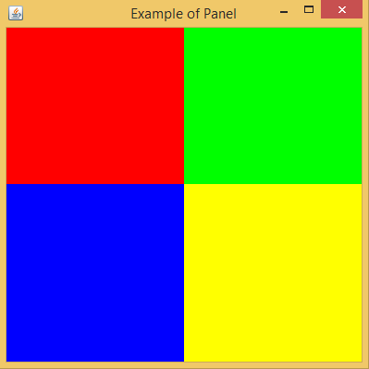
Abstract Window Toolkit (AWT) Secondary Containers :: Panel
Output 1

Slide 30
Abstract Window Toolkit (AWT) Secondary Containers :: Panel
Example 2
import java.awt.*; public class Panel_2 extends Frame { public Panel_2() { setTitle("Panel Example"); Panel p1 = new Panel(); p1.setBounds(0,0,200,200); p1.setBackground(Color.red); Panel p2 = new Panel(); p2.setBounds(200,0,200,200); p2.setBackground(Color.green); Panel p3 = new Panel(); p3.setBounds(0,200,200,200); p3.setBackground(Color.blue); | Panel p4 = new Panel(); p4.setBounds(200,200,200,200); p4.setBackground(Color.yellow); add(p1); add(p2); add(p3); add(p4); setSize(400,400); setVisible(true); } public static void main(String args[]) { Panel_2 ex_p_2 = new Panel_2(); } }

Slide 31
Abstract Window Toolkit (AWT) Secondary Containers :: Panel
Output 2

Slide 32
Abstract Window Toolkit (AWT) Components
Java AWT Components

Slide 33
Abstract Window Toolkit (AWT) Components :: Label
Label is a passive control
Because it does not create any event when accessed by the user
A label
Displays a single line of read-only text
Can be changed by the application programmer
Cannot be changed by the end user in any way

Slide 34
Abstract Window Toolkit (AWT) Components :: Label
Field
static int CENTER
Indicates that the text in the label should be centered
static int LEFT
Indicates that the text in the label should be left justified
static int RIGHT
Indicates that the text in the label should be right justified

Slide 35
Abstract Window Toolkit (AWT) Components :: Label
Constructors
Label()
Constructs an empty label
Label(String text)
Constructs a new label with the specified string of text, left justified
Label(String text, int alignment)
Constructs a new label that presents the specified string of text with the specified alignment

Slide 36
Abstract Window Toolkit (AWT) Components :: Label
import java.awt.*; class AWT_Example_1 extends Frame { public AWT_Example_1 () { Label l1 = new Label("First Label."); l1.setBounds(50,100, 100,30); Label l2 = new Label("Second Label.“, Label.CENTER); l2.setBounds(50,150, 100,30); add(l1); add(l2); } public static void main(String args[]) { AWT_Example_1 e_1 = new AWT_Example_1(); e_1.setSize(400,400); e_1.setLayout(null); e_1.setVisible(true); } }

Slide 37
Abstract Window Toolkit (AWT) Components :: TextField
The textField component
Allows to edit single line of text
When the user types a key in the text field
The event is sent to the TextField
The key event may be
Key pressed, Key released or Key typed
The key event
Passed to the registered KeyListener

Slide 38
Abstract Window Toolkit (AWT) Components :: TextField
TextField()
Constructs a new text field
TextField(int columns)
Constructs a new empty text field with specified number of columns
TextField(String text)
Constructs a new text field initialized with the specified text
TextField(String text, int columns)
Constructs a new text field initialized with the specified text to be displayed
Wide enough to hold the specified number of columns

Slide 39
Abstract Window Toolkit (AWT) Components :: TextField
import java.awt.*; class AWT_Example_2 extends Frame { public AWT_Example_2() { Label l1 = new Label("First Label."); l1.setBounds(50,100, 100,30); TextField t1= new TextField (“Text Field“, 10); t1.setBounds(50,150, 100,30); add(l1); add(t1); } public static void main(String args[]) { AWT_Example_2 e_2 = new AWT_Example_2(); e_2.setSize(400,400); e_2.setLayout(null); e_2.setVisible(true); } }

Slide 40
Abstract Window Toolkit (AWT) Components :: Button
A control component
Has a label
Generates an event when pressed
When pressed and released
AWT sends an instance of ActionEvent to the button
By calling processEvent on the button
The processEvent method receives all events for the button
It passes an action event along by calling its own processActionEvent method
The latter method passes the action event on to any action listeners
That have registered an interest in action events generated by the button

Slide 41
Abstract Window Toolkit (AWT) Components :: Button
Constructors
Button()
Constructs a button with an empty string for its label
Button(String text)
Constructs a new button with specified label

Slide 42
Abstract Window Toolkit (AWT) Components :: Button
import java.awt.*; class AWT_Example_3 extends Frame { public AWT_Example_3() { Label l1 = new Label("First Label."); l1.setBounds(50,100, 100,30); TextField t1= new TextField (“Text Field"); t1.setBounds(50,150, 100,30); Button b1 = new Button("Click"); b1.setBounds(150,150, 100,30); add(l1); add(t1); add(b1); } | public static void main(String args[]) { AWT_Example_3 e_3 = new AWT_Example_3(); e_3.setSize(400,400); e_3.setLayout(null); e_3.setVisible(true); } }

Slide 43
Abstract Window Toolkit (AWT) Components :: Checkbox
A checkbox
Used to turn an option
on (true) or off (false)
Clicking on a Checkbox
Changes its state
From on to off or from off to on

Slide 44
Abstract Window Toolkit (AWT) Components :: Checkbox & CheckboxGroup
Constructors
Checkbox()
Creates a check box with an empty string for its label
Checkbox(String label)
Creates a check box with the specified label
Checkbox(String label, boolean state)
Creates a check box with the specified label and sets the specified state
Checkbox(String label, boolean state, CheckboxGroup group)
Constructs a Checkbox with the specified label, set to the specified state, and in the specified check box group
Checkbox(String label, CheckboxGroup group, boolean state)
Creates a check box with the specified label, in the specified check box group, and set to the specified state

Slide 45
Abstract Window Toolkit (AWT) Components :: Checkbox
import java.awt.*; class AWT_Example_4 { public AWT_Example_4 () { Frame f = new Frame(“AWT Example"); f.setBackground(Color.BLUE); Label l1 = new Label("First Label."); l1.setBackground(Color.yellow); l1.setBounds(50,100, 100,30); TextField t1 = new TextField("Write Text Here"); t1.setBackground(Color.yellow); t1.setBounds(50,170, 100,30); Checkbox cb1 = new Checkbox("Select"); cb1.setBackground(Color.yellow); cb1.setBounds(50,240, 50,50); Button b1 = new Button("Click"); b1.setBackground(Color.yellow); b1.setBounds(50,300, 100,30); | f.add(l1); f.add(t1); f.add(cb1); f.add(b1); f.setSize(400,400); f.setLayout(null); f.setVisible(true); } public static void main(String args[]) { AWT_Example_4 e_4 = new AWT_Example_4(); } }

Slide 46
Abstract Window Toolkit (AWT) Components :: CheckboxGroup
The CheckboxGroup is
Groups a set of Checkbox together
At a time, only one check box is allowed to be in on state
Remaining check boxes in off state
CheckboxGroup is used to create radio buttons
No special control for creating radio buttons in AWT

Slide 47
Abstract Window Toolkit (AWT) Components :: RadioButton
import java.awt.*; class AWT_Example_4 { public AWT_Example_4 () { Frame f = new Frame(“AWT Example"); f.setBackground(Color.BLUE); Label l1 = new Label("First Label."); l1.setBackground(Color.yellow); l1.setBounds(50,100, 100,30); TextField t1 = new TextField("Write Text Here"); t1.setBackground(Color.yellow); t1.setBounds(50,170, 100,30); Checkbox cb1 = new Checkbox("Select"); cb1.setBackground(Color.yellow); cb1.setBounds(50,240, 50,50); CheckboxGroup cbg = new CheckboxGroup(); Checkbox cb2 = new Checkbox("C++", cbg, false); cb2.setBackground(Color.yellow); cb2.setBounds(50,200, 50,50); | Checkbox cb3 = new Checkbox("Java", cbg, true); cb3.setBackground(Color.yellow); cb3.setBounds(50,270, 50,50); Button b1 = new Button("Click"); b1.setBackground(Color.yellow); b1.setBounds(50,300, 100,30); f.add(l1); f.add(t1); f.add(cb1); f.add(cb2); f.add(cb3); f.add(b1); f.setSize(400,400); f.setLayout(null); f.setVisible(true); } public static void main(String args[]) { AWT_Example_4 e_4 = new AWT_Example_4(); } }

Slide 48
Abstract Window Toolkit (AWT) Layout Managers
The Layout Managers are
Used to arrange components in a particular manner
LayoutManager is
An interface
That is implemented by all the classes of layout managers
Different classes that represents the layout managers
java.awt.BorderLayout java.awt.FlowLayout java.awt.GridLayout java.awt.CardLayout java.awt.GridBagLayout | javax.swing.BoxLayout javax.swing.GroupLayout javax.swing.ScrollPaneLayout javax.swing.SpringLayout etc.

Slide 49
Abstract Window Toolkit (AWT) Layout Manager :: BorderLayout
The BorderLayout is used
To arrange the components in five regions
north, south, east, west and center
Each region (area)
May contain one component only
Default layout of
Frame or Window
Provides five constants for each region
public static final int NORTH
public static final int SOUTH
public static final int EAST
public static final int WEST
public static final int CENTER

Slide 50
Abstract Window Toolkit (AWT) Layout Manager :: BorderLayout
Constructors
BorderLayout()
Creates a border layout but with no gaps between the components
BorderLayout(int hgap, int vgap)
Creates a border layout with the given horizontal and vertical gaps between the components

Slide 51
Abstract Window Toolkit (AWT) Layout Manager :: BorderLayout
import java.awt.*; class AWT_Example_7 { public AWT_Example_7 () { Frame f = new Frame("BorderLayout Example"); f.setLayout(new BorderLayout()); // f.setLayout(new BorderLayout(5, 5)); Label l1 = new Label("NORTH", Label.CENTER); l1.setBackground(Color.RED); Label l2 = new Label("CENTER", Label.CENTER); l2.setBackground(Color.GREEN); Label l3 = new Label("SOUTH", Label.CENTER); l3.setBackground(Color.BLUE); Label l4 = new Label("EAST", Label.CENTER); l4.setBackground(Color.YELLOW); Label l5 = new Label("WEST", Label.CENTER); l5.setBackground(Color.CYAN); | f.add(l1,BorderLayout.NORTH); f.add(l2, BorderLayout.CENTER); f.add(l3,BorderLayout.SOUTH); f.add(l4, BorderLayout.EAST); f.add(l5,BorderLayout.WEST); f.setSize(400,400); f.setVisible(true); } public static void main(String args[]) { AWT_7 awt_7 = new AWT_7(); } }

Slide 52
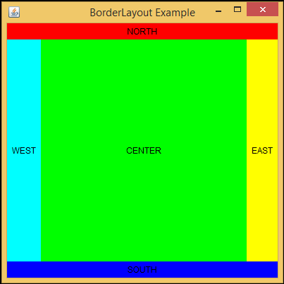
Abstract Window Toolkit (AWT) Layout Manager :: BorderLayout
Output :

Slide 53
Abstract Window Toolkit (AWT) Layout Manager :: FlowLayout
FlowLayout is
Used to arrange components
In a sequence one after the other
The default layout of
Applet and Panel
Constructors
FlowLayout()
Constructs a new FlowLayout
With a centered alignment
A default 5-unit horizontal and vertical gap
FlowLayout(int align)
Constructs a new FlowLayout with the specified alignment
A default 5-unit horizontal and vertical gap
FlowLayout(int align, int hgap, int vgap)
Creates a new flow layout manager with the indicated alignment
The indicated horizontal and vertical gaps

Slide 54
Abstract Window Toolkit (AWT) Layout Manager :: FlowLayout
Fields
static int CENTER
Each row of components should be centered
static int LEADING
Each row of components should be justified to the leading edge of the container's orientation
For example, to the left in left-to-right orientations
static int LEFT
Each row of components should be left-justified
static int RIGHT
Each row of components should be right-justified
static int TRAILING
Each row of components should be justified to the trailing edge of the container's orientation
For example, to the right in left-to-right orientations

Slide 55
Abstract Window Toolkit (AWT) Layout Manager :: FlowLayout
import java.awt.*; class AWT_Example_8 { public AWT_Example_8 () { Frame f = new Frame(“FlowLayout Example"); f.setLayout(new FlowLayout(FlowLayout.LEFT, 10,10)); f.setLayout(new FlowLayout(FlowLayout.LEFT)); // f.setLayout(new FlowLayout(FlowLayout.RIGHT)); // f.setLayout(new FlowLayout(FlowLayout.CENTER)); // f.setLayout(new FlowLayout(FlowLayout.TRAILING)); // f.setLayout(new FlowLayout(FlowLayout.LEADING)); Label l1 = new Label(“Label 1", Label.CENTER); l1.setBackground(Color.RED); Label l2 = new Label("Label 2", Label.CENTER); l2.setBackground(Color.GREEN); Label l3 = new Label("Label 3", Label.CENTER); l3.setBackground(Color.BLUE); Label l4 = new Label("Label 4", Label.CENTER); l4.setBackground(Color.YELLOW); Label l5 = new Label("Label 5", Label.CENTER); l5.setBackground(Color.CYAN); | f.add(l1); f.add(l2); f.add(l3); f.add(l4); f.add(l5); f.setSize(400,400); f.setVisible(true); } public static void main(String args[]) { AWT_8 awt_8 = new AWT_8(); } }

Slide 56
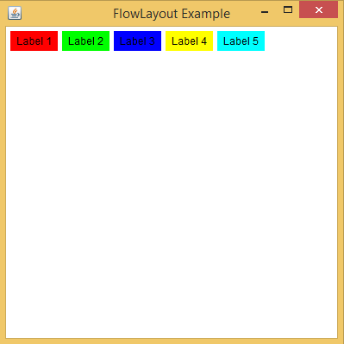
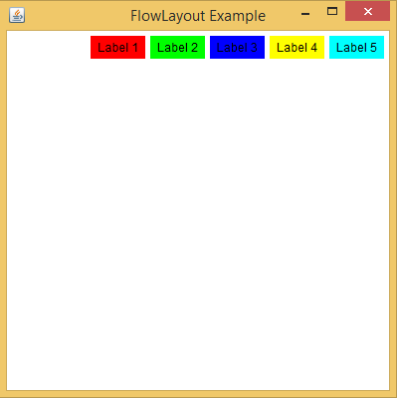
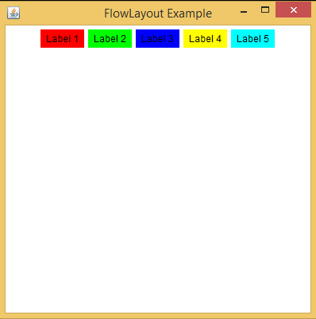
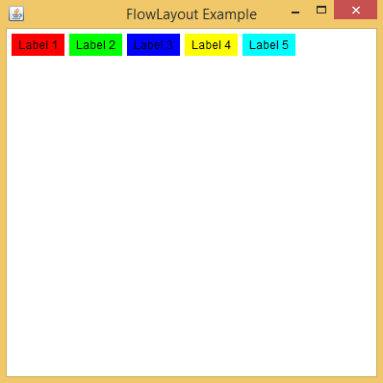

Abstract Window Toolkit (AWT) Layout Manager :: FlowLayout
Output :
Used Field Used Field
FlowLayout.LEFT FlowLayout.RIGHT
Used Field Used Field Used Field
FlowLayout.CENTER FlowLayout.LEADING FlowLayout.TRAILING

Slide 57
Abstract Window Toolkit (AWT) Layout Manager :: GridLayout
In GridLayout
The components are arranged in rectangular grid
One component is displayed in each rectangle
Constructors
GridLayout()
Creates a grid layout with one column per component in a row
GridLayout(int rows, int columns)
Creates a grid layout with the given rows and columns but no gaps between the components
GridLayout(int rows, int columns, int hgap, int vgap)
Creates a grid layout with the given rows and columns along with given horizontal and vertical gaps

Slide 58
Abstract Window Toolkit (AWT) Layout Manager :: GridLayout
import java.awt.*; class AWT_Example_9 { public AWT_Example_9 () { Frame f = new Frame(“FlowLayout Example"); // f.setLayout(new GridLayout()); // f.setLayout(new GridLayout(2, 3)); f.setLayout(new GridLayout(2, 3, 5, 5)); Label l1 = new Label("NORTH", Label.CENTER); l1.setBackground(Color.RED); Label l2 = new Label("CENTER", Label.CENTER); l2.setBackground(Color.GREEN); Label l3 = new Label("SOUTH", Label.CENTER); l3.setBackground(Color.BLUE); Label l4 = new Label("EAST", Label.CENTER); l4.setBackground(Color.YELLOW); Label l5 = new Label("WEST", Label.CENTER); l5.setBackground(Color.CYAN); | f.add(l1); f.add(l2); f.add(l3); f.add(l4); f.add(l5); f.setSize(400,400); f.setVisible(true); } public static void main(String args[]) { AWT_9 awt_9 = new AWT_9(); } }

Slide 59
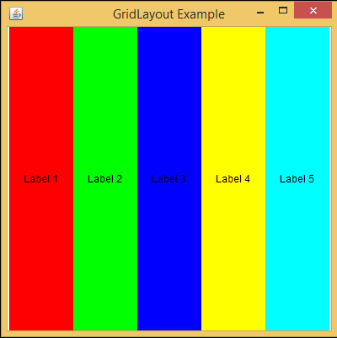
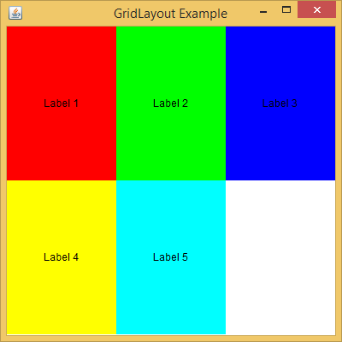

Abstract Window Toolkit (AWT) Layout Manager :: GridLayout
Output :
Using constructor Using constructor
GridLayout() GridLayout(int row, int col)
Using constructor
GridLayout(int row, int col, int hgap, int vgap)

Slide 60
Abstract Window Toolkit (AWT) Layout Manager :: GridBagLayout
The GridBagLayout is used to align
Components vertically, horizontally or along their baseline
May not be of same size
Each GridBagLayout object
Maintains a dynamic, rectangular grid of cells
Each component occupies one or more cells known as its display area
Each component is
Associated with an instance of GridBagConstraints
With the help of constraints object
Component's display area is arranged on the grid
The GridBagLayout
Manages each component's minimum and preferred sizes in order to determine component's size

Slide 61
Abstract Window Toolkit (AWT) Layout Manager :: GridBagLayout
Variable | Role
gridx and gridy | These contain the coordinates of the origin of the grid. They allow a at a specific position of a component positioning. By default, they have GrigBagConstraint.RELATIVE value which indicates that a component can be stored to the right of previous
Gridwidth and gridheight | Define how many cells will occupy component (height and width). by The default is 1. The indication is relative to the other components of the line or the column. The GridBagConstraints.REMAINDER value specifies that the next component inserted will be the last of the line or the current column. The value GridBagConstraints.RELATIVE up the component after the last component of a row or column.
fill | Defines the fate of a component smaller than the grid cell. The GridBagConstraints.NONE retains the original size: Default. The GridBagConstraints.HORIZONTAL expanded Horizontally The GridBagConstraints.VERTICAL and GridBagConstraints.BOTH expanded vertically to the dimensions of the cell
Ipadx and ipady | Used to define the horizontal and vertical expansion of components. not works if expansion is required by fill. The default value is (0,0).
anchor | When a component is smaller than the cell in which it is inserted, it can be positioned using this variable to define the side from which the control should be aligned within the cell. Possible variables NORTH, NORTHWEST, NORTHEAST, SOUTH, SOUTHWEST, SOUTHEAST, WEST and EAST
Weightx and weighty | Used to define the distribution of space in case of change of dimension

Slide 62
Abstract Window Toolkit (AWT) Layout Manager :: GridBagLayout
Constructor
GridBagLayout()
Creates a grid bag layout manager

Slide 63
Abstract Window Toolkit (AWT) Layout Manager :: GridBagLayout
import java.awt.*; class AWT_Example_10 extends Frame { public AWT_Example_10 () { setLayout(new GridBagLayout()); Label l1 = new Label("Name"); l1.setBackground(Color.GREEN); TextField t1 =new TextField(10); t1.setBackground(Color.RED); Label l2 = new Label("Comments"); l2.setBackground(Color.GREEN); TextField t2 = new TextField(50); t2.setBackground(Color.RED); Button b1 = new Button("Ok"); GridBagConstraints gc =new GridBagConstraints(); add(l1, gc, 0, 0, 1, 1, 0, 0); add(t1, gc, 1, 0, 1, 1, 0, 20); add(l2, gc, 0, 1, 1, 1, 0, 0); add(t2, gc, 1, 1, 1, 1, 0, 60); add(b1, gc, 0, 2, 2, 1, 0, 20); } | void add(Component c, GridBagConstraints gc, int x, int y ,int w, int h, int wx, int wy) { gc.gridx = x; gc.gridy = y; gc.gridwidth = w; gc.gridheight= h; gc.weightx = wx; gc.weighty = wy; add(comp,gc); } public static void main(String args[]) { AWT_10 awt_10 = new AWT_10(); awt_10.setTitle("GridBagLayout Example"); awt_10.setSize(500,400); awt_10.setVisible(true); } }

Slide 64
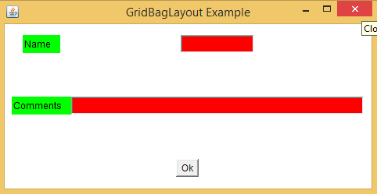
Abstract Window Toolkit (AWT) Layout Manager :: GridLayout
Output :

Slide 65
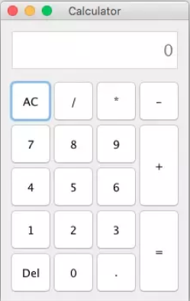
Abstract Window Toolkit (AWT)
Home Work:
Create a GUI as shown in the following figure

